Slide 1







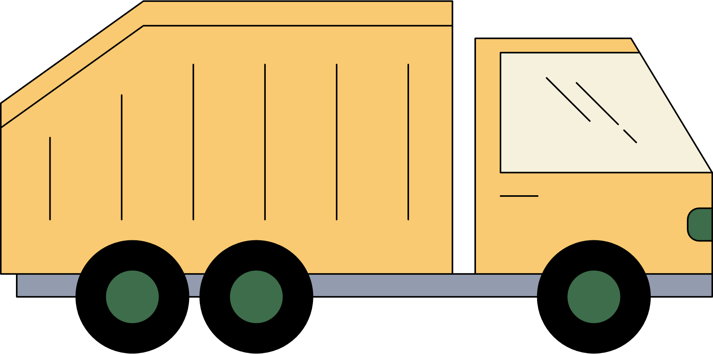


TEAM ERROR 404
TEAM MEMBERS:
-> Geetish Mahato
->Aditi Singh
-> Ishan Sahu
-> Anamika Dey
-> Pragya Kumar
@Binsense

Slide 2

PROBLEM STATEMENT:
Traditional waste collection systems rely on fixed schedules and manual oversight, leading to inefficiencies, overflowing bins, and unhygienic conditions. The lack of real-time monitoring and intelligent decision-making results in delayed responses, inefficient routing, and poor resource utilization.
Key Issues :
Fixed collection schedules result in inefficient pickups
Overflowing bins pose health and environmental risks
Lack of real-time monitoring delays clearance and response
Inefficient routing increases fuel usage and municipal expenses
Lack of data-driven decisions limits system scalability and workforce planning
@Binsense

Slide 3







OUR SOLUTION :
To address inefficiencies in urban waste collection, BinSense offers a real-time monitoring and analytics solution using IoT sensors, Firebase, and a geospatial dashboard built with Leaflet.js.
How it Works?
IoT sensors track bin fill levels and transmit data via ESP8266 microcontrollers to the Firebase.
A web dashboard displays bin locations on a live city map using Leaflet.js, with bins color-coded by fill level: Green = Empty, Yellow = Moderate, Red = Full
AI modules analyze historical fill patterns to:
Recommend the bin size (Small, Medium, Large) for future placement.
Suggest the required number of cleaning personnel (3, 5, or 7) based on bin size.
Real-time alerts enable fuel-efficient collection routes and allocate resources effectively.
This system reduces response delays, prevents overflows, and improves hygiene and operational efficiency in city-wide waste management.
@Binsense

Slide 4
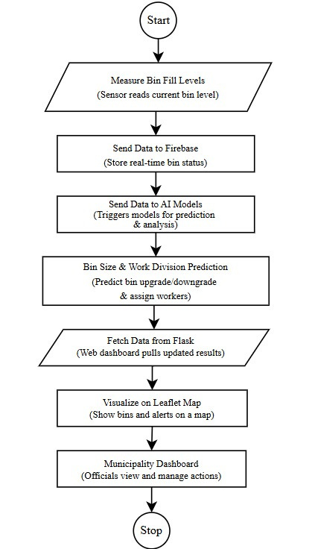
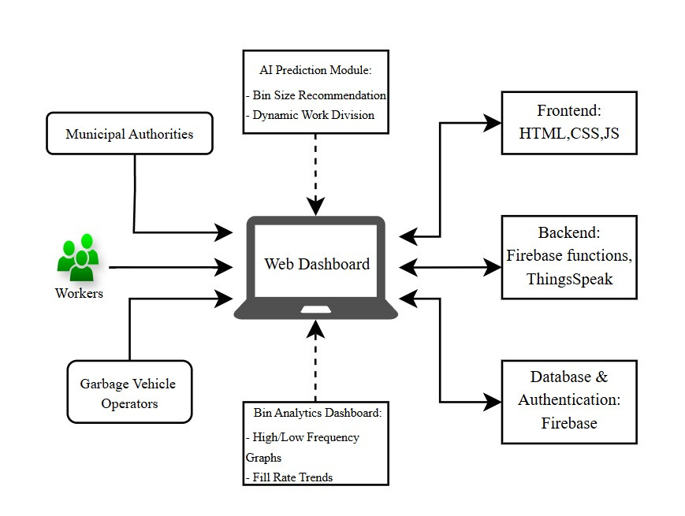
SYSTEM ARCHITECTURE
DIAGRAM
USER FLOW DIAGRAM
@Binsense

Slide 5
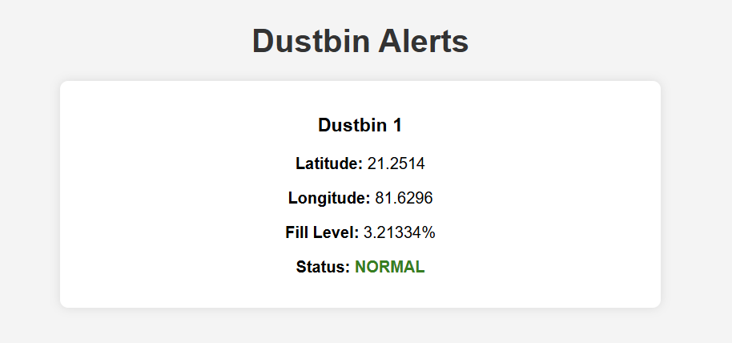
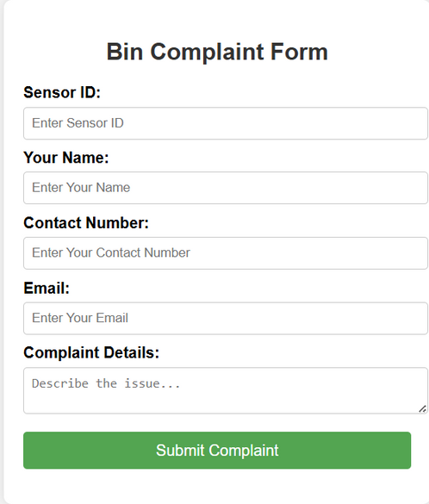
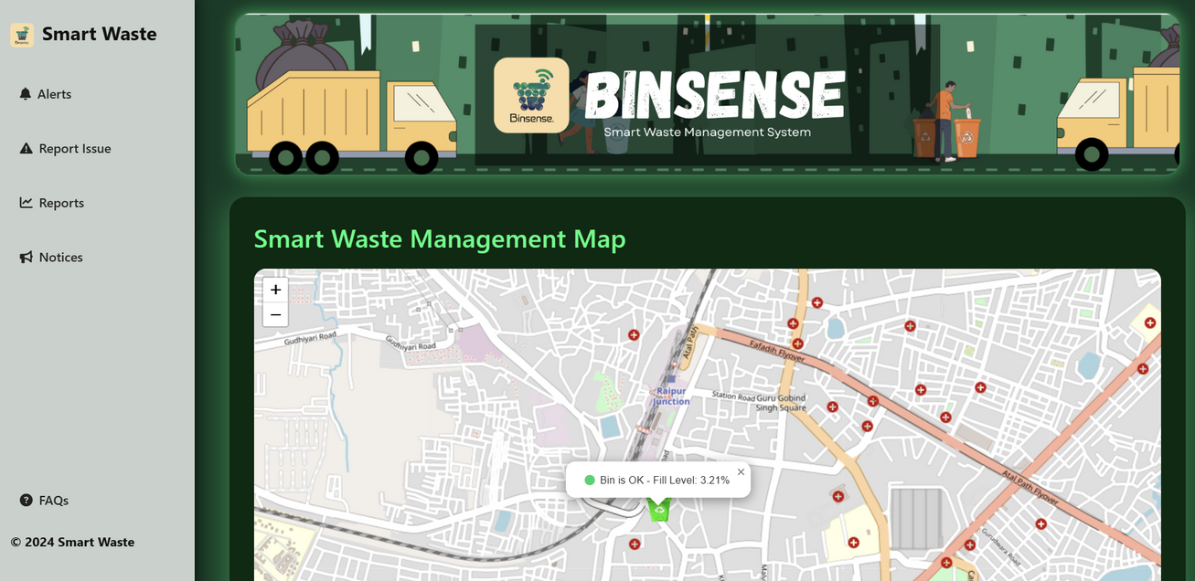
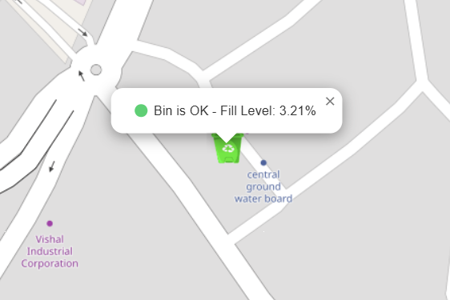
WORKING MODEL
OF THE APPLICATION
@Binsense

Slide 6







TECHNOLOGIES USED
Software Components:
Firebase – Stores and syncs bin status data.
Leaflet.js – Displays bins on a real-time map.
HTML, CSS, JavaScript – Frontend for dashboard and visualization.
Python Libraries: Tensorflow, Keras, Scikit learn for AI-ML Model.
Hardware Components:
Ultrasonic Sensor (HC-SR04) – Measures bin fill levels.
NodeMCU ESP8266 – Microcontroller for IoT connectivity.
Jumper Wires .
DIY Dustbin .
Battery or Power Adapter .
@Binsense

Slide 7



FEASIBILITY:
IMPACT & BENEFITS
✔ Technical Feasibility – Uses readily available IoT sensors, Firebase for cloud storage, and Leaflet.js for visualization.
✔ Economic Feasibility – Low-cost components
✔ Operational Feasibility – Simple web-based dashboard allows easy adoption by municipal authorities.
✔ Scalability – Can be expanded to multiple cities by adding more IoT-enabled bins.
✔ Optimized waste collection – Reduces fuel & time waste.
✔ Cleaner environment – Prevents overflowing bins & pollution.
✔ Cost-effective – Lowers municipal expenses.
✔ Real-time monitoring – Faster response to full bins.
✔ Smart city integration – Supports urban digitalization.
✔ Scalable & automated – Expands easily with less manual work.
Smart waste management aligns with Swachh Bharat Mission and Smart City projects, making it eligible for grants.
@Binsense

Slide 8
FUTURE SCOPE
As urban challenges grow, BinSense can evolve into a fully autonomous, data-driven waste management platform.
Key future enhancements include:
Predictive Analytics: Analyze historical bin fill patterns to forecast future waste levels, enabling proactive pickups and reducing overflows.
AI-Based Route Optimization: Dynamically generate optimal collection routes based on real-time bin status, traffic data, and vehicle capacity to save time and fuel.
Integration with Municipal ERP Systems: Seamless data exchange with government platforms for better reporting, accountability, and city-wide resource planning.
Sustainability & Waste Pattern Analysis: Monitor long-term trends to inform policy decisions, promote eco-friendly practices, and align with Smart City and Swachh Bharat Mission goals.
@Binsense

Slide 9
CONCLUSION
BinSense presents a robust, scalable solution to modern waste management challenges by combining IoT infrastructure, real-time data visualization, and AI-driven intelligence.
Through continuous monitoring, dynamic bin sizing recommendations, and efficient resource allocation, our system transforms traditional waste collection into a proactive, adaptive, and data-centric process.
Core Outcomes:
Enables real-time operational visibility for municipalities
Applies AI for informed decision-making in bin sizing and workforce deployment
Reduces fuel usage, response time, and environmental risks
Lays the groundwork for integration into smart city ecosystems
BinSense advances the state of urban sanitation—through engineering precision, data intelligence, and system-level thinking.
@Binsense

Slide 10




@Binsense

